Slide 1
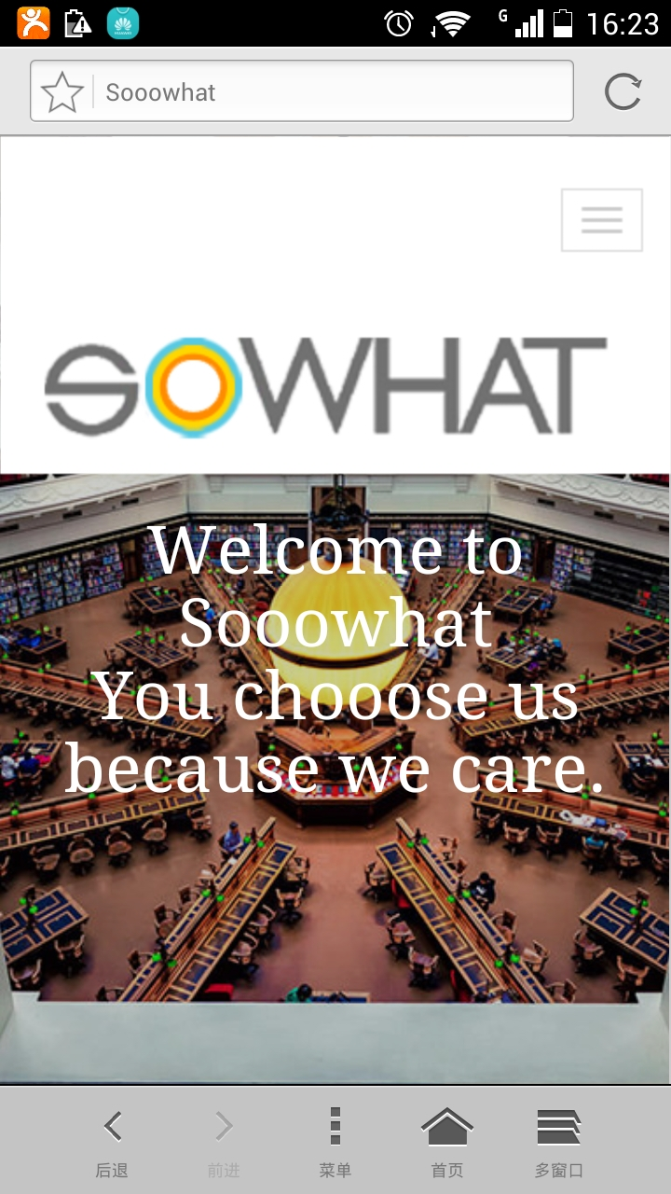

SOWHAT logo should include the headline above the brand name.
All fonts must be Century Gothic.
No two brands are the same. However, we believe great brands have one thing in common: they are all intrigued by a powerful insight, and turned that into a BIG idea.
SoooWHAT is a group of brand lovers who are curious about consumers and passionate about unleashing the big idea for great brands.
From day one, we knew that SoooWHAT was special. In truth we never liked to confine ourselves to being just another ‘insight or consulting agency'. The notion of the big brand idea has always driven our everyday work, and inspire the way we approach a business problem.

Slide 2
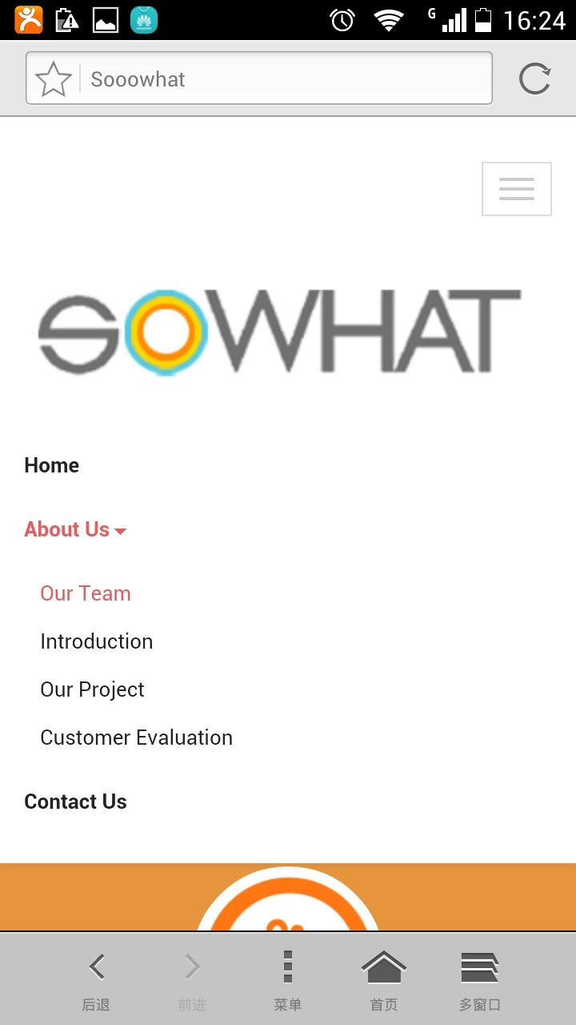
网站导航
Can include the following items:
Our Motto
Our Work
Our People
Contact us

Slide 3
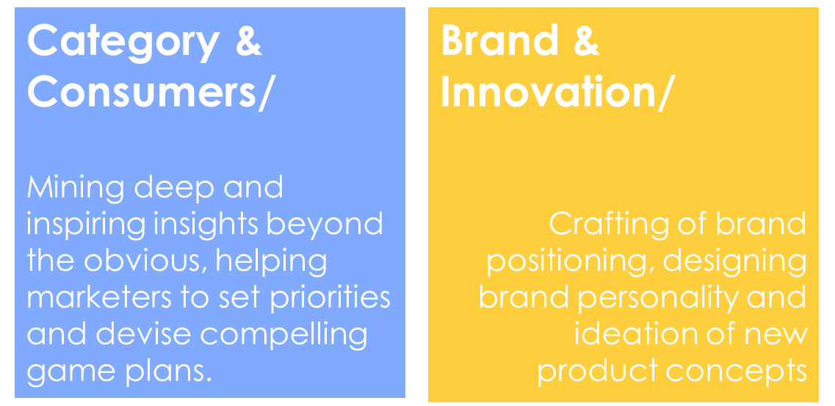
Our Expertise
Building and nurturing a desirable brand takes hard work and expertise. Our talent and experience makes us good in solving two types of marketing questions.
Category & Consumers/
Mining deep and inspiring insights beyond the obvious, helping marketers to set priorities and devise compelling game plans.
Brand & Innovation/
Crafting of brand positioning, designing brand personality and ideation of new
product concepts
Our Expertise
Building and nurturing a desirable brand takes hard work and expertise. Our talent and experience makes us good in solving two types of marketing questions.
Our job is simple and yet challenging.
We validate your thoughts, we enlighten you with new thinking and we try our very best to inspire you with intriguing ideas. We go beyond the obvious and ask the tougher question, i.e., so what?
Our job is simple and yet challenging.
We validate your thoughts, we enlighten you with new thinking and we try our very best to inspire you with intriguing ideas. We go beyond the obvious and ask the tougher question, i.e., so what?

Slide 4
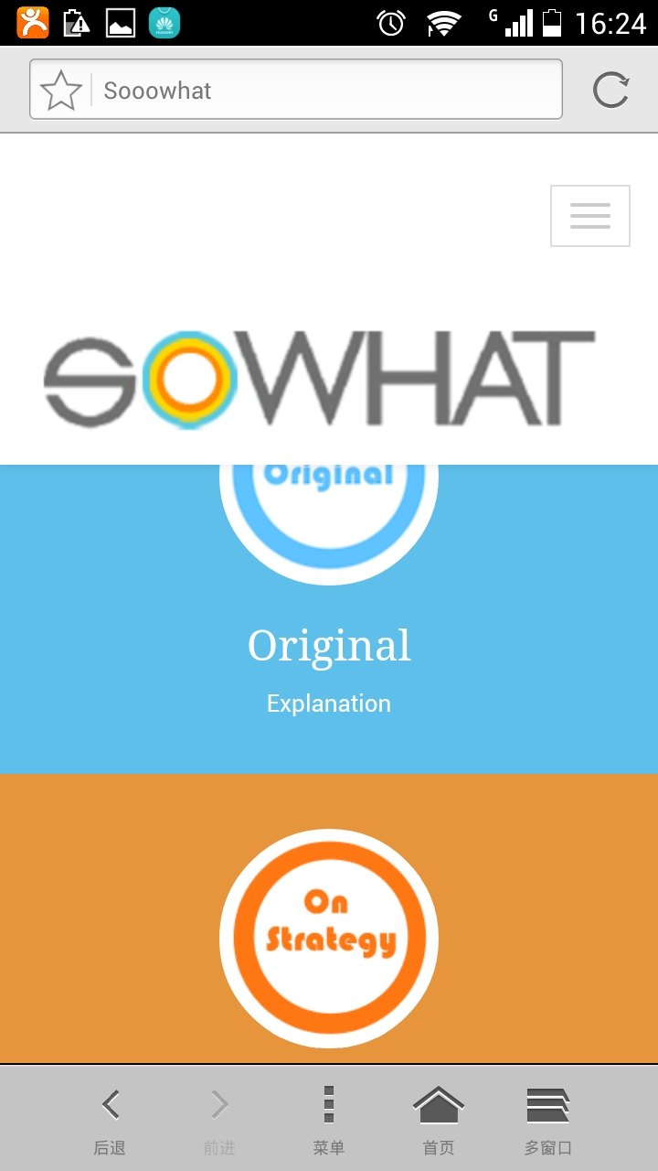

Our Mottos
We are not happy with being average and ordinary. Our mottos raise the bar and define what we aim to deliver in every piece of our work.
Original
fresh and alternate thinking. having a unique and yet practical angle for real life application.
Out of the box not bound by but challenging the
status quo, bringing inspirations to the thought process.
On strategy
recommendations are always aligned with brand strategy, aiming at driving brand growth.
The 3 mottos should be placed horizontally, i.e., you see them all at the same time.

Slide 5
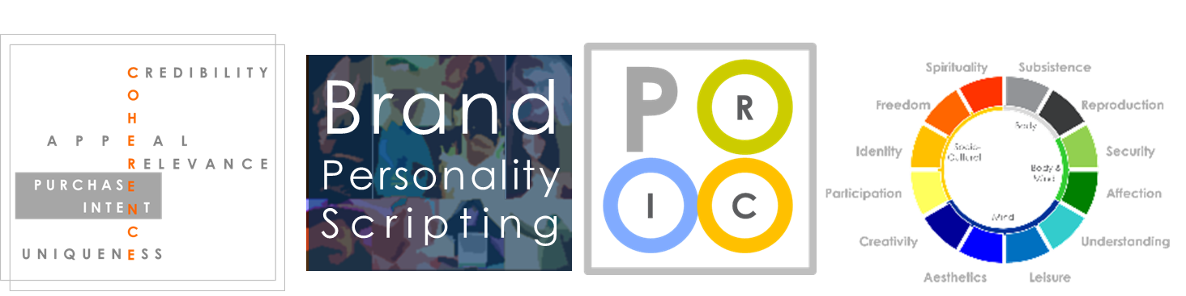
To help crack some of the most tricky marketing questions, creative thinking is employed on top of insightful data. And based on years of experience in the field, we developed great tools to cumulate powerful knowledge over the years.
To help crack some of the most tricky marketing questions, creative thinking is employed on top of insightful data. And based on years of experience in the field, we developed great tools to cumulate powerful knowledge over the years.
Coherence Gauge for measuring potential of new ideas
Personality Scripter
for developing touching brand personality
P.R.I.C. Model
for assessing communication effectiveness
Human Need Territory for inspiring new perspectives of brand offers
Our job is simple and yet challenging.
We validate your thoughts, we enlighten you with new thinking and we try our very best to inspire you with intriguing ideas. We go beyond the obvious and ask the tougher question, i.e., so what?
Our job is simple and yet challenging.
We validate your thoughts, we enlighten you with new thinking and we try our very best to inspire you with intriguing ideas. We go beyond the obvious and ask the tougher question, i.e., so what?

Slide 6
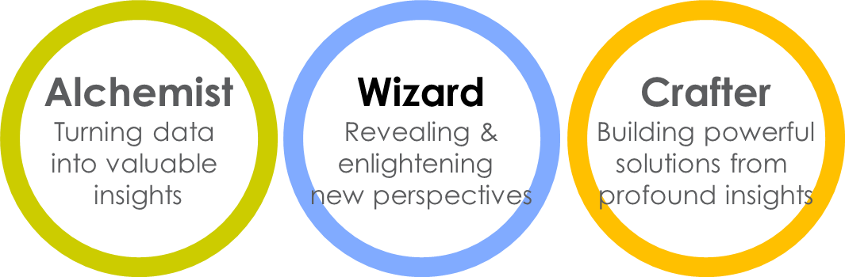
Our People
We were called by many names, from insight researchers, brand marketers, idea generators, problem solvers, or simply trusted partners.
Conventional titles do not adequately describe our work, and they are a bit boring to us. We decided to brand ourselves differently.
Our People
We were called by many names, from insight researchers, brand marketers, idea generators, problem solvers, or simply trusted partners.
Conventional titles do not adequately describe our work, and they are a bit boring to us. We decided to brand ourselves differently.
Alchemist
Turning data
into valuable
insights
Wizard
Revealing &
enlightening
new perspectives
Crafter
Building powerful
solutions from
profound insights

Slide 7
Contact us
If you have a business issue to solve, or feel intrigued with the opportunity of working in this truly interesting agency, please contact us:
Contact us
Send
Or you can find us at the following:
Add: Unit 203, Block 16, Lane 118, Rui Jing 1sr Road, Huangpu District, Shanghai, PRC, 200020
Tel: (8621) 5459 1887

Slide 8
